Slide 1
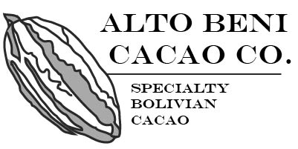
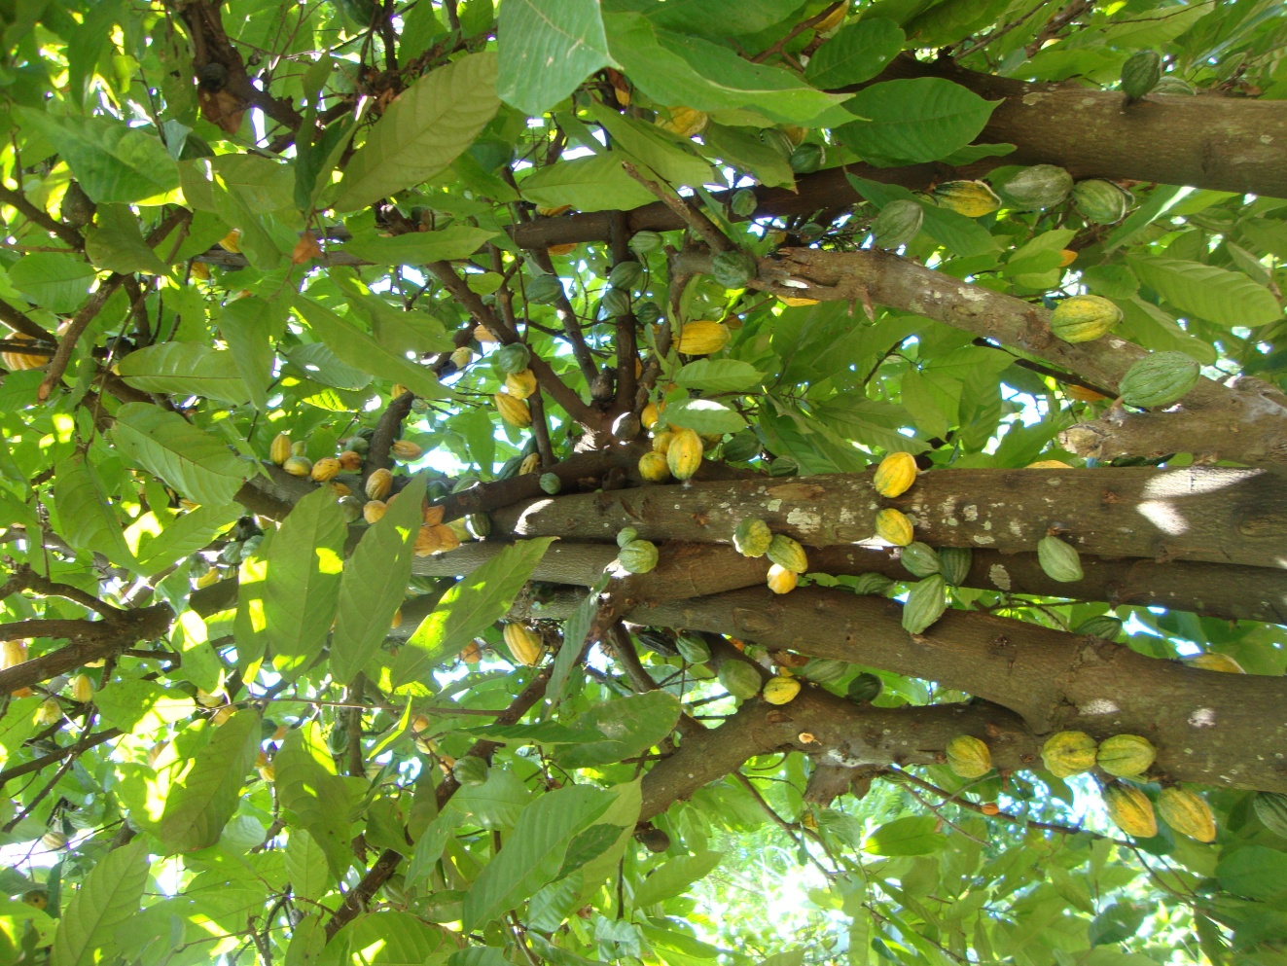
“Development of a High Quality Cacao Industry in Alto Beni, Bolivia”
PRESENTADO POR:
INVALSA CACAO

Slide 2
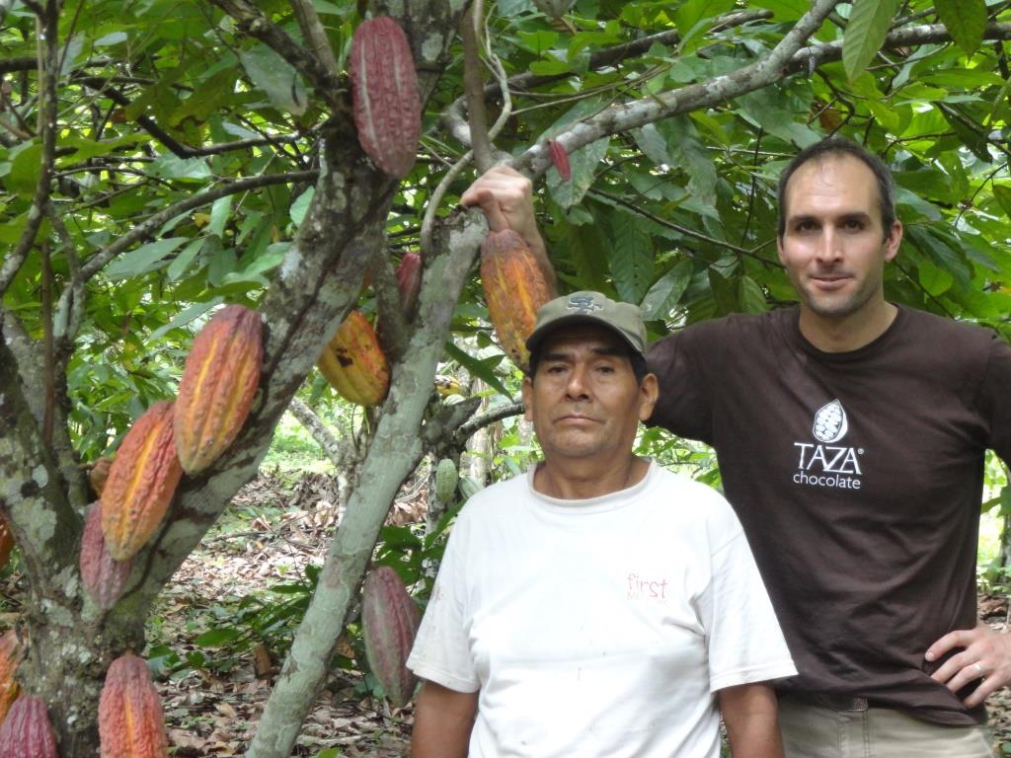
Baseline Production
Baseline production is by 135 smallholder families distributed among eight communities, organized into the cooperative, Central Integral Agroecológica Alto Beni (CIAAB).
The area is in the municipalities of Palos Blancos and Alto Beni, in the Department of La Paz, at the following coordinates:
67º20’04’’ y 66º58’32’’ longitude West
15º33’32’’ y 15º47’28’’ latitude South

Slide 3
Baseline Indicators
Descripción | Valor
Hectares of Cacao | 324
Has of Cacao per producer | 2.4
Average Yield (metric tons / ha) | 0.4
Average Annual Production (metric tons) | 0.9
Annual Net Income (US$) | $3,000
Smallholder families | 135
Average family size | 3.5

Slide 4
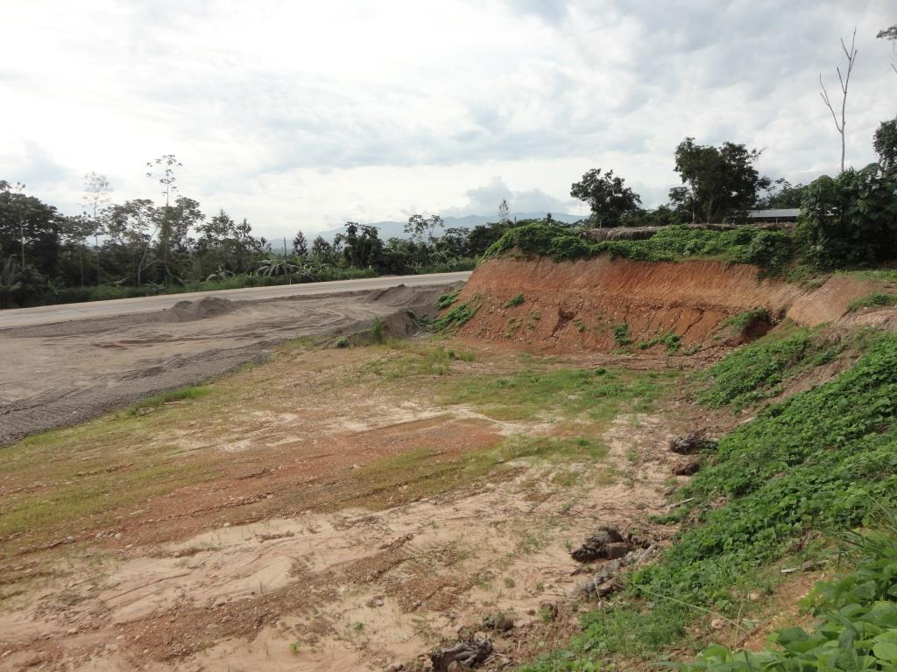
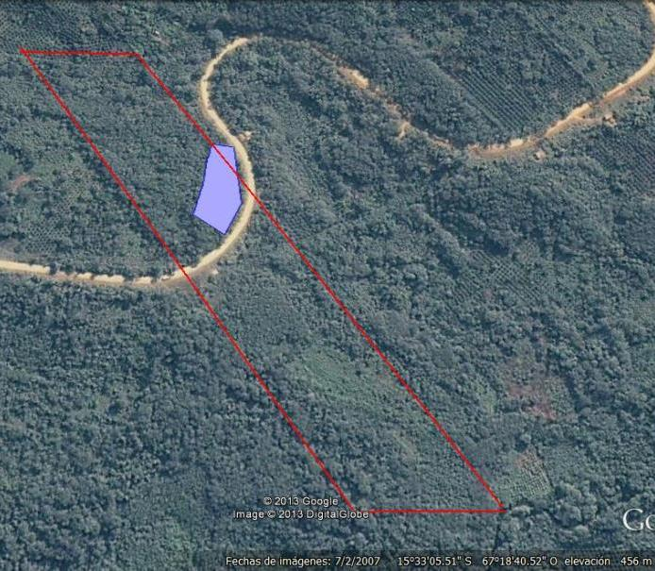
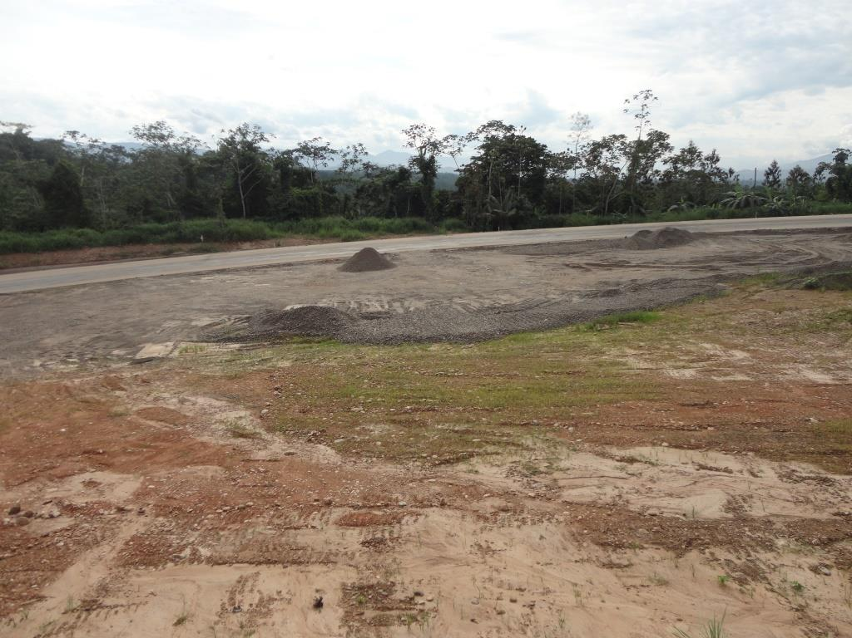
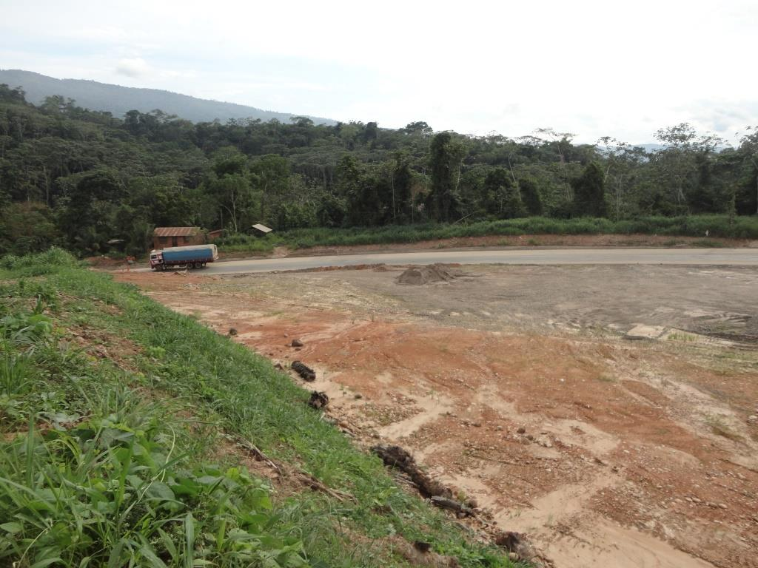
Location of Fermentation Plant to be Constructed

Slide 5
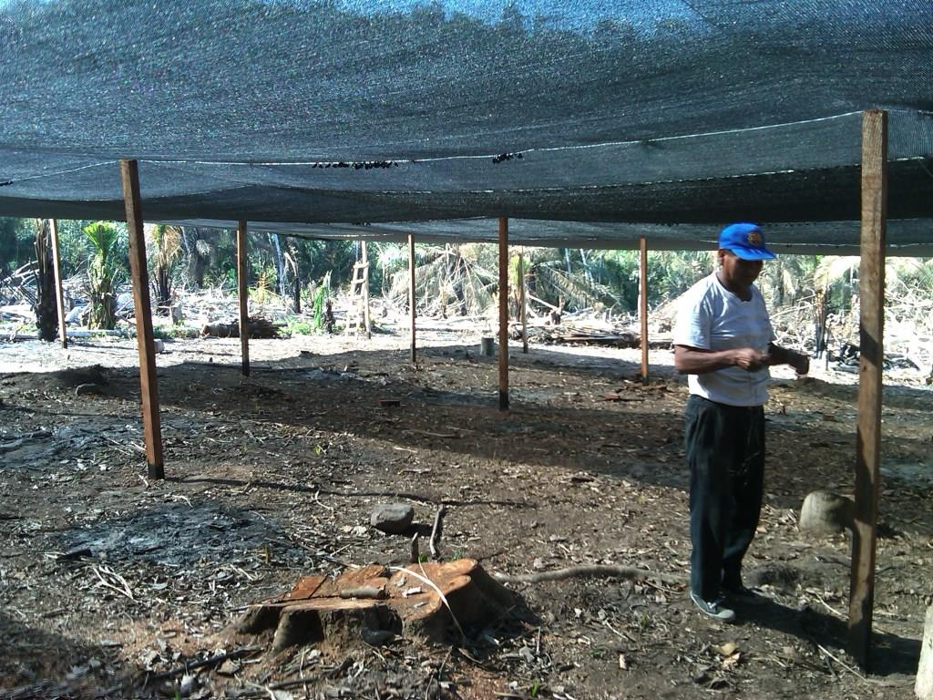
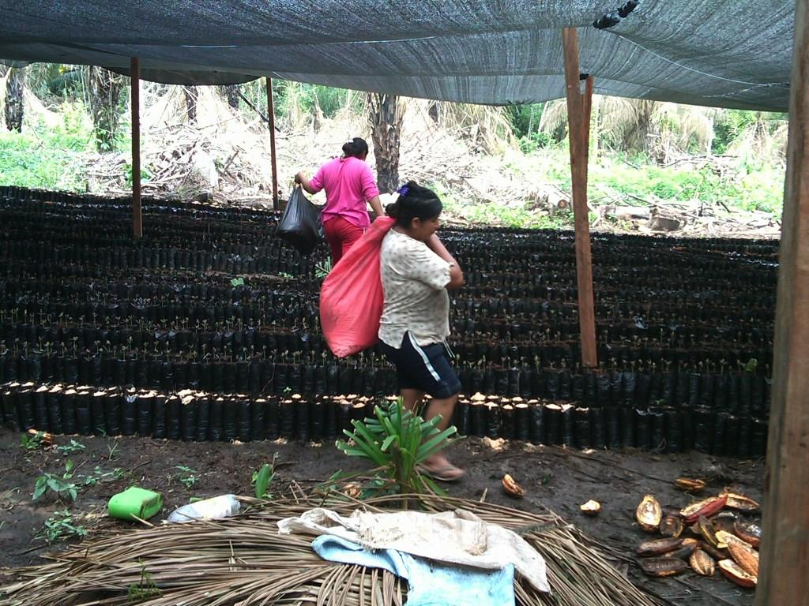
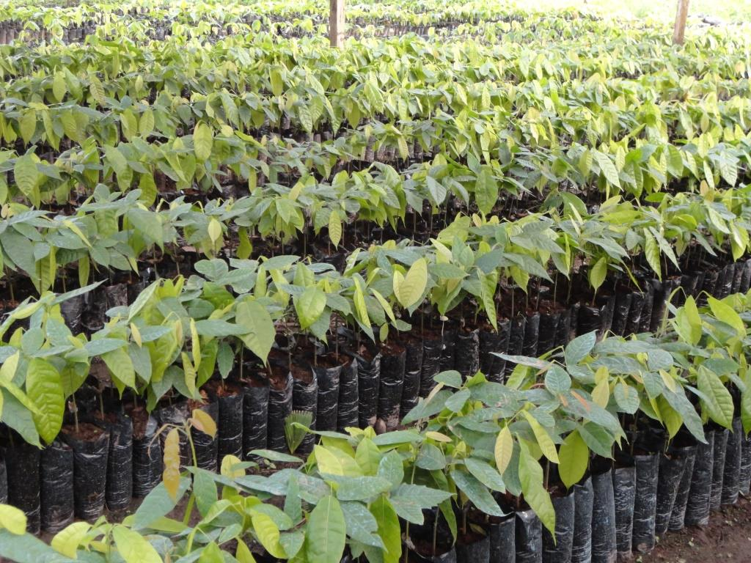
Production of Genetic Material
Nursery construction and planting occurred in summer 2013:
- Nursery área: 625 m2
- Capacity for 25,000 seedlings
- Currently holds 8,200 seedlings
Additional 7 has. of land are being prepared for additional nursery space that can produce 100,000 seedlings per year.
Seedlings under cultivation include a range of foreign and local (South American) hybrid varietals, as well as wild Bolivian cacao varietals, which allows for ongoing field research about the genetics best-suited for Bolivian cacao production.

Slide 6
2014 Goals
Production levels
Increase the quantity of cacao producers and communities so as to use the fermentation mill at full capacity.
Technical assistance for producers focused on pest and disease control, and organic nutrient management methods for cacao.
Cacao Fermentation Plant
Plant constructed and functioning by March 2014, when the Alto Beni cacao harvest beings.
Purchase of cacao en baba; purchasing calendar and routes developed.
Production of Genetic Material
Construct four seedling nurseries with capacity for annual production of 100,000 seedlings.
Graft four (4) has. of cacao with high quality local hybrids.
Graft three (3) has. of cacao with material from wild Bolivian cacao, in coordination with the Bolivian Wildlife Conservation Society (WCS).

Slide 7
GRACIAS

